Slide 1
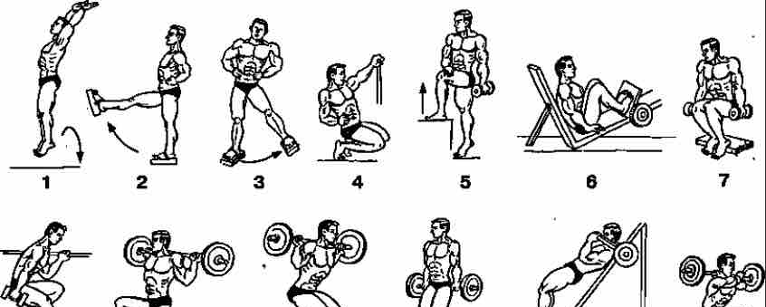
Creating a training plan using machine learning.

Slide 2
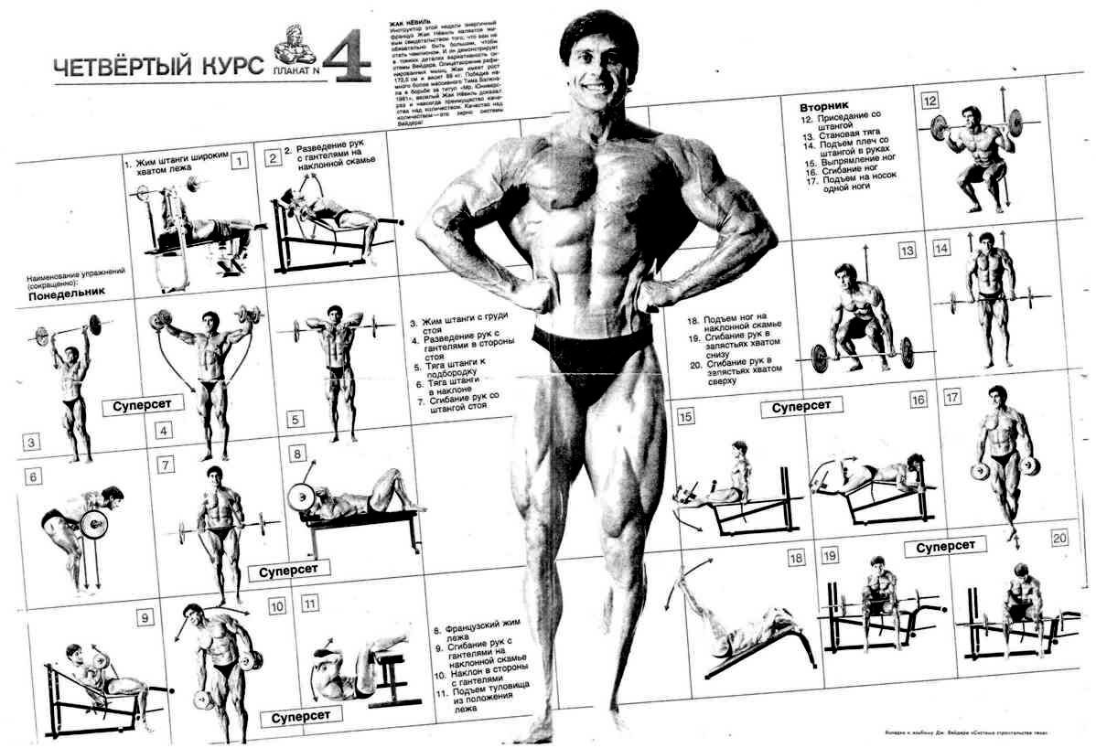
Introduction:
Training planning is an important aspect for achieving athletic goals, but it can be complex and error-prone.
Consider the use of machine learning methods to develop an effective and personalized training plan.

Slide 3
Data analysis:
Collection of data about the athlete: includes information about his physical fitness, health, preferences, goals.
Use of sensors and tracking devices: to obtain more accurate information about physical activity and health indicators.
Data preparation: cleaning, transformation, feature extraction.

Slide 4
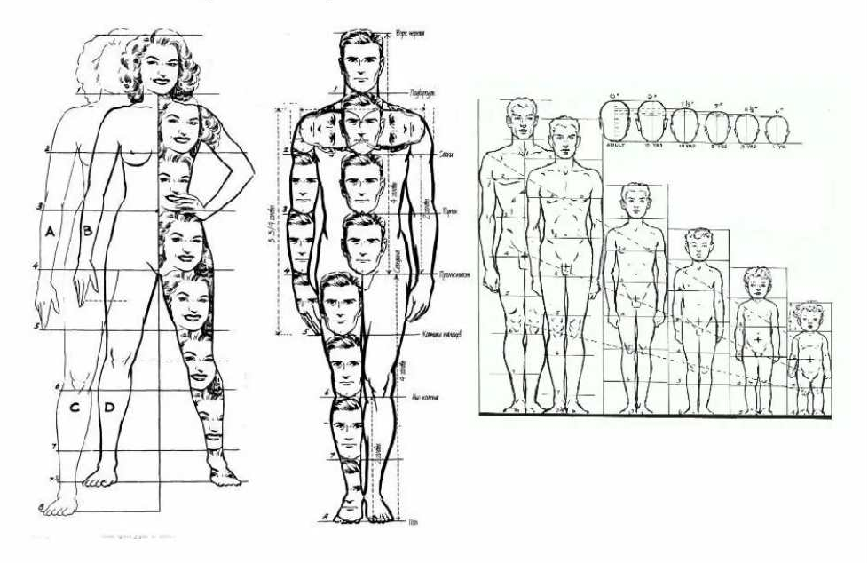
Human proportions

Slide 5
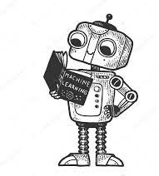
Machine learning methods:
Regression models: for predicting training results based on historical data.
Classification: to determine the optimal types of training depending on your goals.
Clustering: to identify groups of athletes with similar needs and abilities.
Reinforcement learning: for adaptive, real-time training planning.

Slide 6
Stages of developing a training plan:
Identification of athlete's goals and limitations.
Selecting appropriate machine learning methods.
Train the model based on historical data.
Model testing and validation.
Adaptation of the plan during training based on feedback and new data.

Slide 7
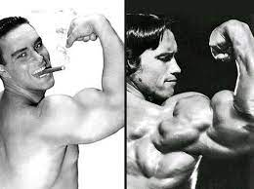
before
after

Slide 8
Benefits of using machine learning in training planning:
Personalization: taking into account individual characteristics and goals.
Efficiency: optimization of the training process to achieve maximum results.
Adaptability: the ability to quickly respond to changes in physical fitness and training conditions.

Slide 9
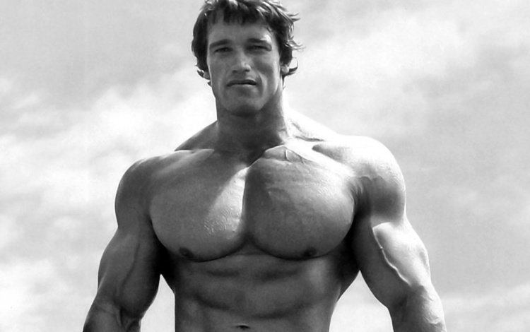
Conclusion:
Machine learning is a powerful tool for creating personalized and effective training plans that can help athletes achieve their goals faster and more efficiently.
Further research and development in this area could lead to even more advanced and adaptive training planning systems.

